Slide 1

ECE 419/619 Electric Machines and Drives
Induction Machines

Slide 2
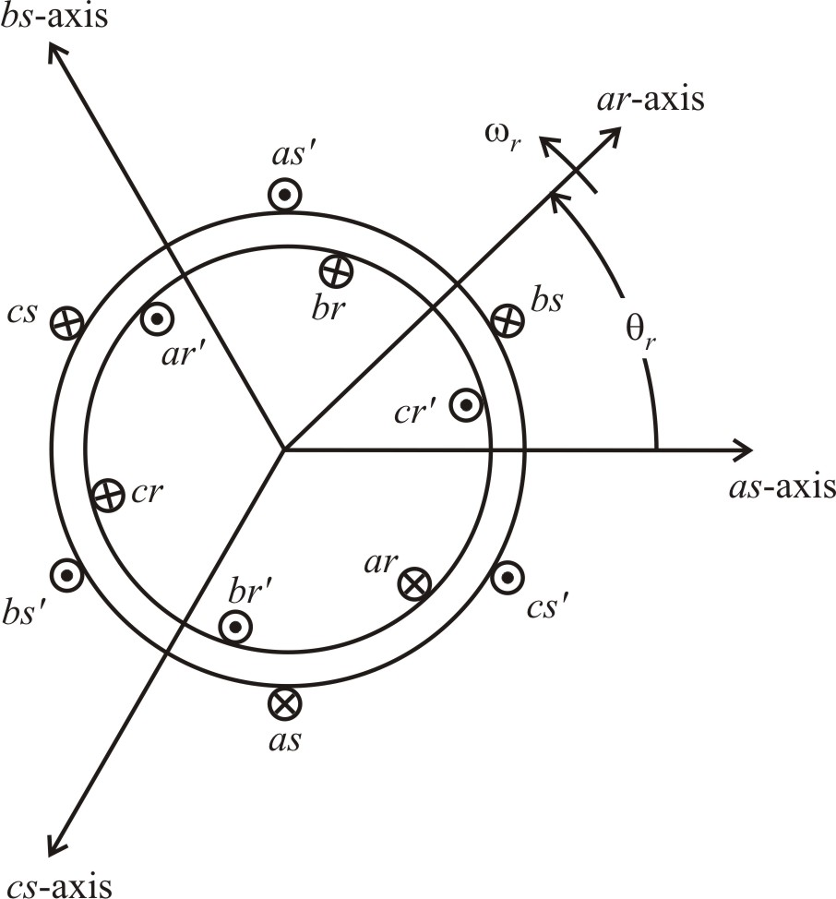
Symmetrical Induction Machines (Chapter 4)
voltage equations
typically wye connected windings

Slide 3
Flux Linkage Equations

Slide 4
Rotor Inductances

Slide 5
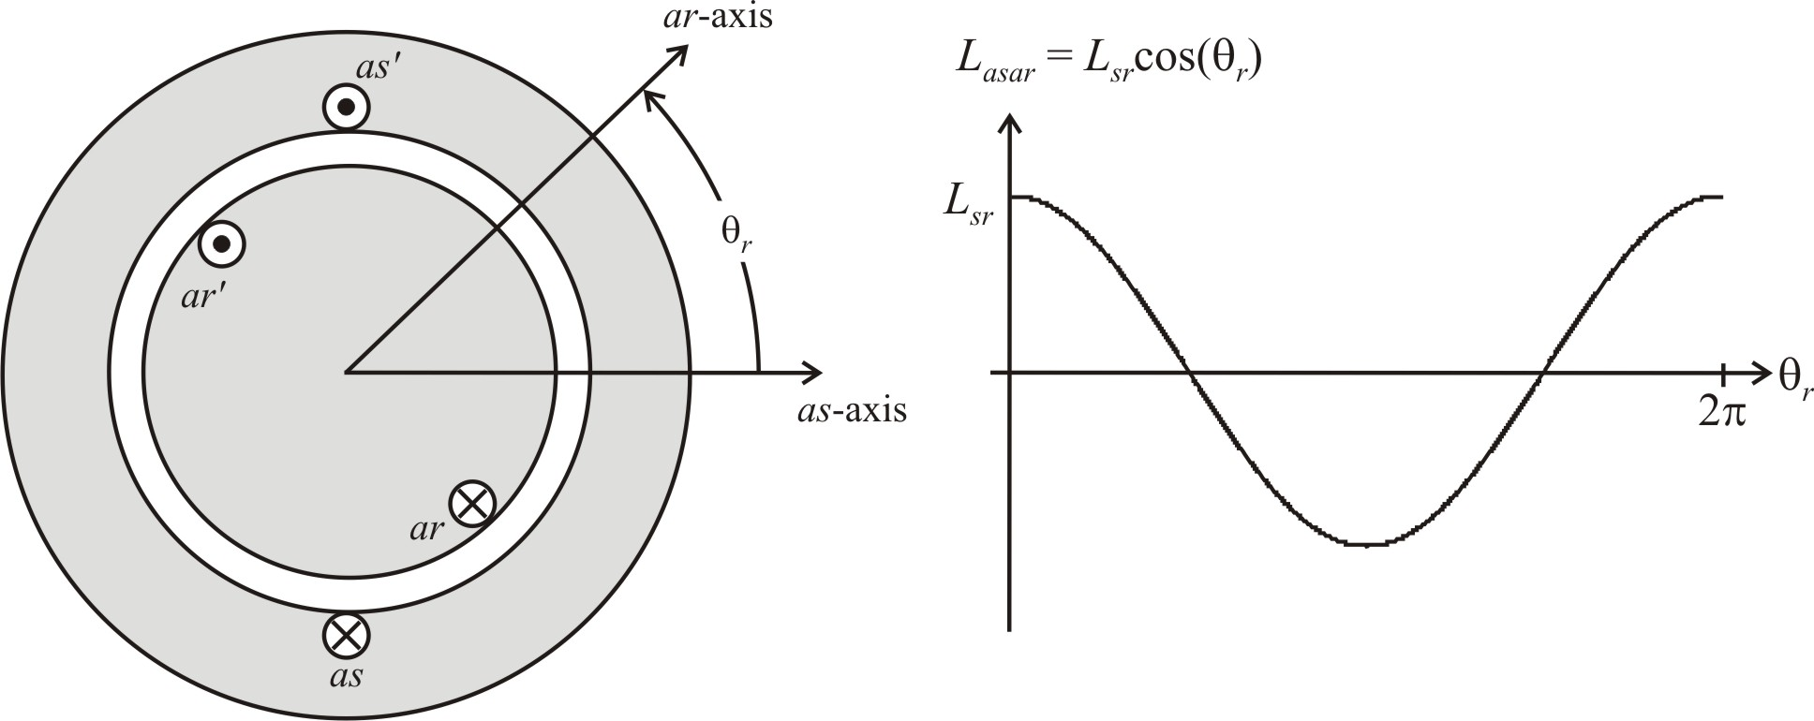
Stator-to-Rotor Inductances
L_{asar} - component of λ_{as} due to i_{ar}

Slide 6
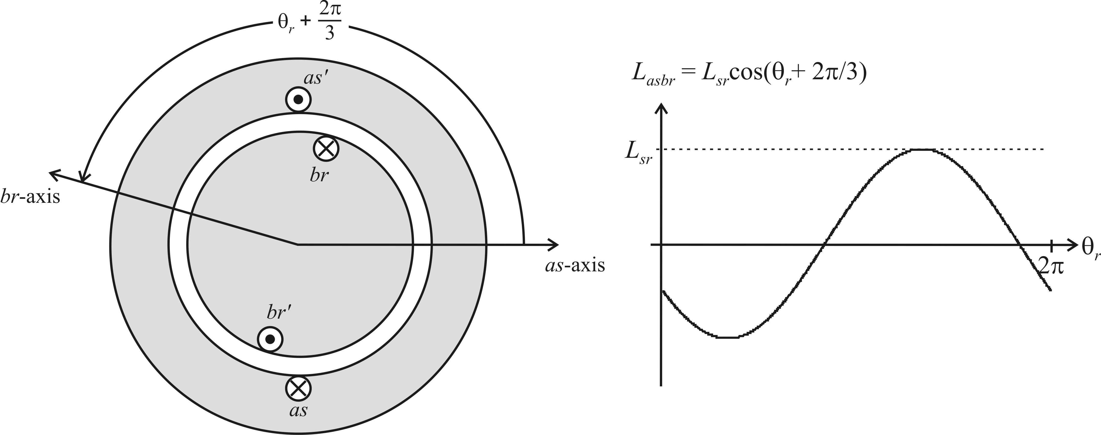
L_{asbr} - component of λ_{as} due to i_{br}

Slide 7
Refer Rotor Quantities to Stator
Put all magnetizing inductances in terms of L_{ms} (Steinmetz model)
define

Slide 9
define

Slide 10
Refer Voltage Equations
Stator
Rotor
define

Slide 11
Induction Machine Model
Based on machine physics
Inductances obtained by inspection, but could be derived (see Chapter 1) and related to machine physical machine dimensions
Rotor referred to stator to simplify steady-state model that will be presented later

Slide 12
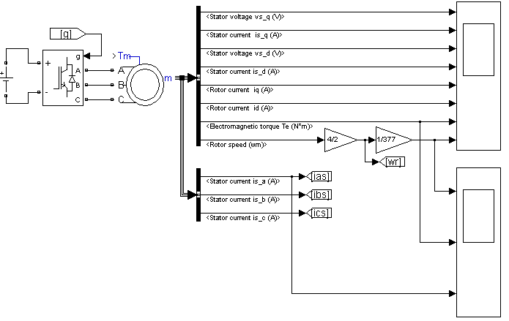
SimPowerSystems IM Model
Notation and model matches the book
Constant speed and free rotor modes
Per unit or SI unit models available
Selectable reference frame
Large number of variables including currents, flux linkages, torque, speed, etc.

Slide 13
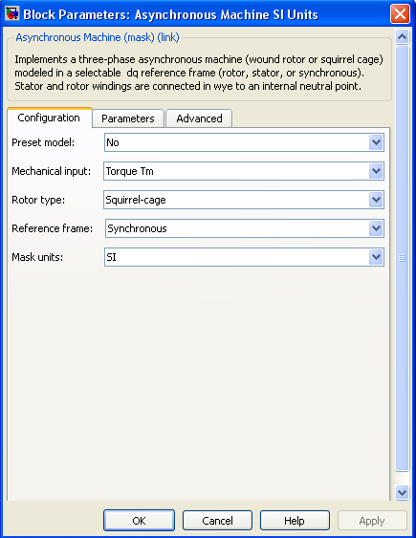
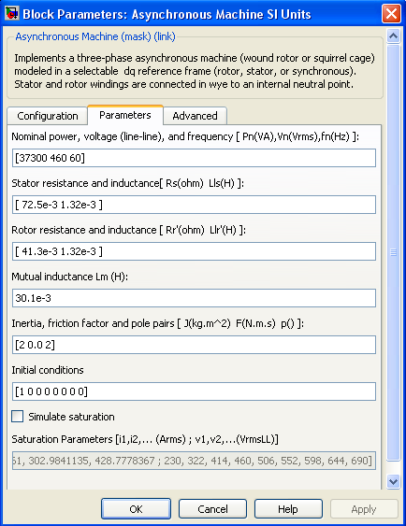
SimPower Blocks IM Model

Slide 14
PSCAD IM Model
A, B, C, N - stator electrical terminals
a b c - rotor electrical terminals
S = 1 - constant speed mode
S = 0 - mechanical equations
W - speed when S = 1
initial speed when S = 0
expressed in per unit as ω_{r} / ω_{e}
TL - load torque when S = 0

Slide 15
IM Per-Unit Example

Slide 16
IM Per-Unit Example

Slide 17
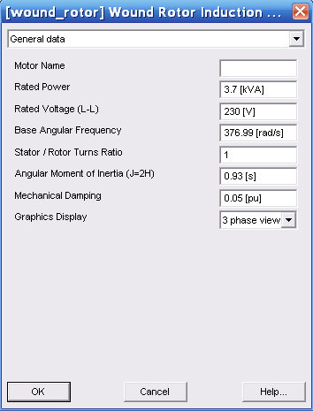
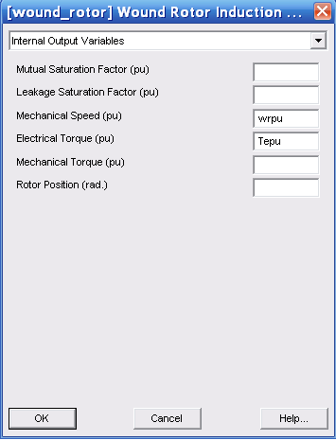
IM Per-Unit Example

Slide 18
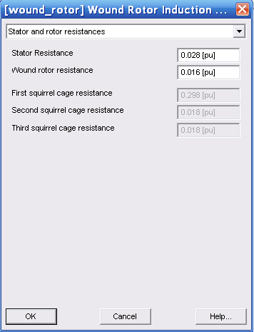
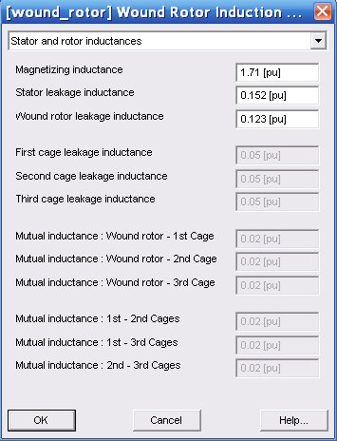
IM Per-Unit Example

Slide 19
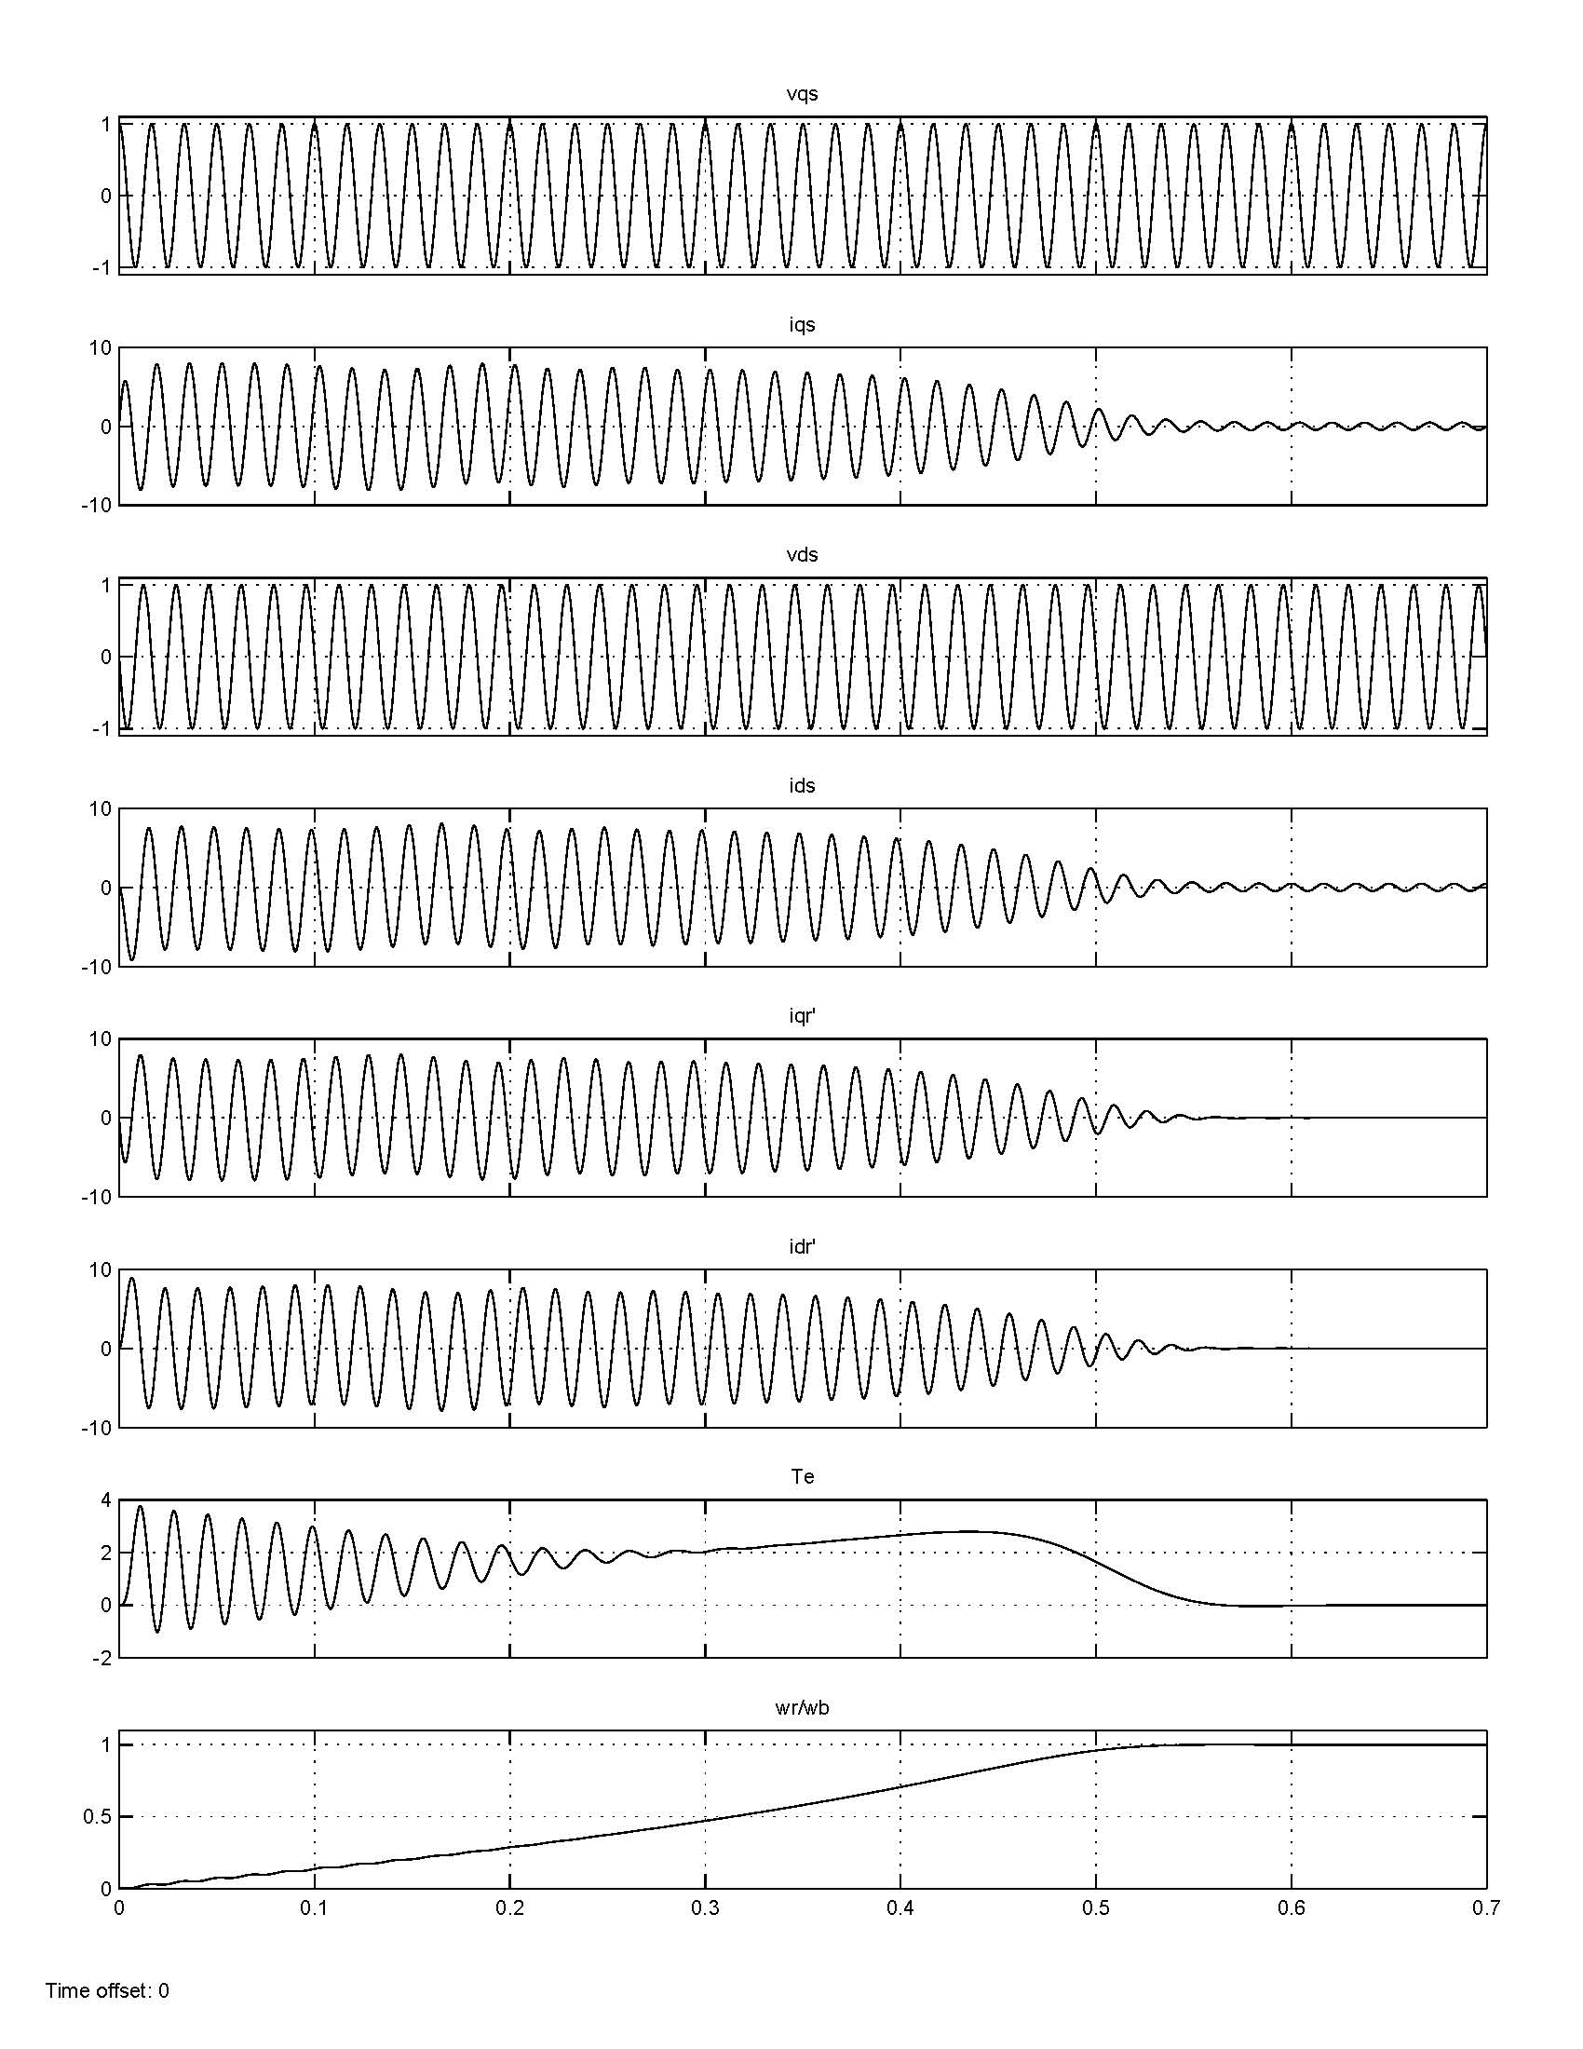
Induction Motor Start-up
see Figure 4.11-2 in the book

Slide 20
Induction Machine Simulation
Transient and steady-state performance prediction
Flux linkages or currents can be state variables
Simulink and PSCAD models are based on classical models with some additional features such as saturation
Simulink: parameters in SI units (or per-unit) using the same model as in the book.
PSCAD: parameters entered in per-unit. Internal output variables in per-unit.

Slide 21
IM Steady-State Calculations
Instantaneous voltages
voltage phasors
constant ω_{rm}
define slip

Slide 22
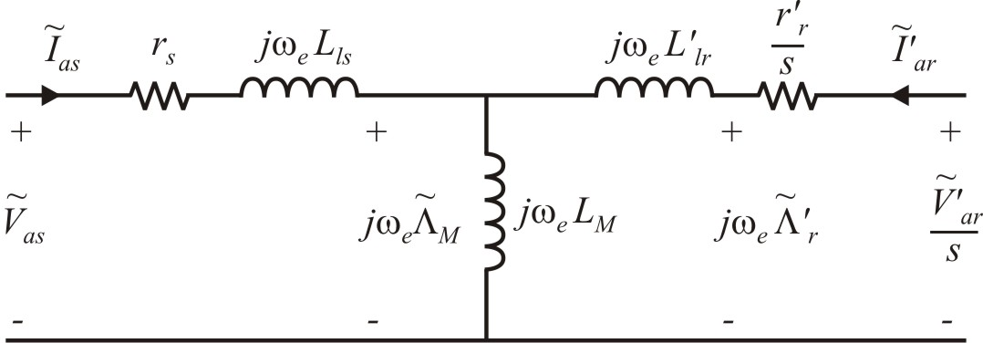
Per-Phase Steady-State Circuit
squirrel cage

Slide 23
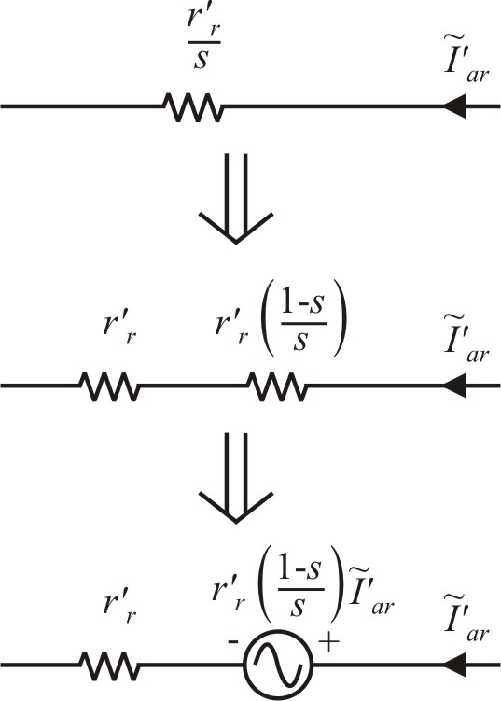
Steady-State (Average) Torque

Slide 24
Torque in Terms of Voltage
input impedance
currents
torque

Slide 25
Steady-State Calculations (Per-Phase Model)

Slide 26
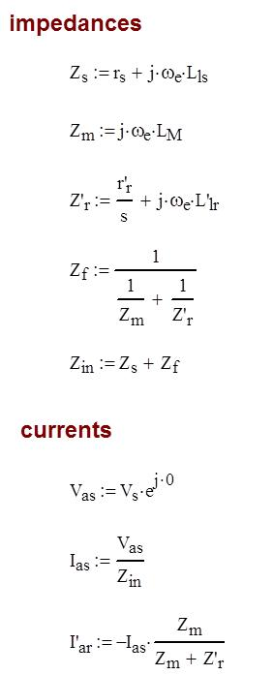
Steady-State Calculations (Per-Phase Model)

Slide 27
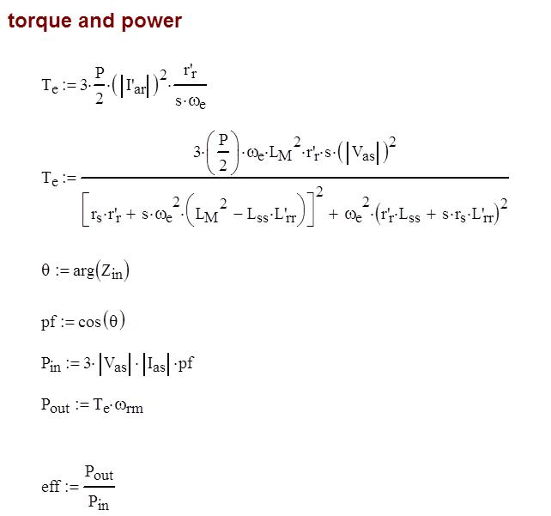
Steady-State Calculations (Per-Phase Model)

Slide 28
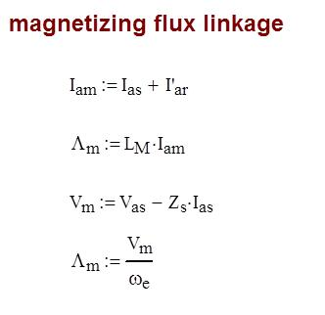
Steady-State Calculations (Per-Phase Model)

Slide 29
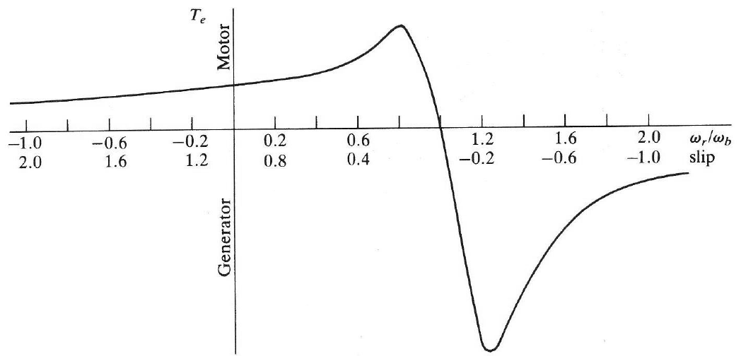
Peak Torque

Slide 30
IM Steady-State Model
Straightforward and quick calculation of steady-state operation
Model provides insight into motor operation
Can be used to predict peak torque, stall torque, and starting current

Slide 31
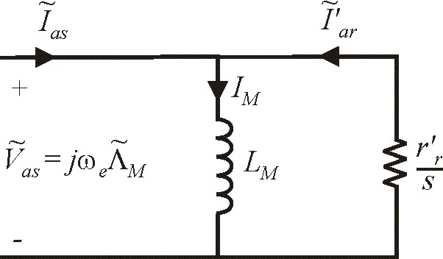
Simplified IM Steady-State Model
Note: model suggest
Torque proportional to slip
Torque inversely proportional to rotor resistance
Torque proportional to stator voltage squared

Slide 32
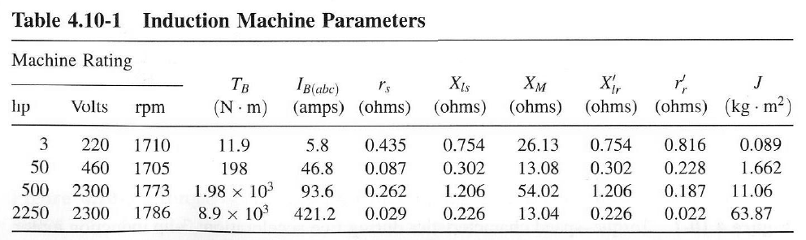
Calculations Using the Simplified Model
Note
Inertia is proportional to power rating
Rotor resistance is small for large machines

Slide 37
Magnetizing Flux Linkage
Model also suggests that magnetizing flux linkage
can be controlled by applied stator voltage

Slide 38
Induction Machine Simplified Model
Simple determination of steady-state operation
Accurate in normal operation close to no-load speed

